Slide 1

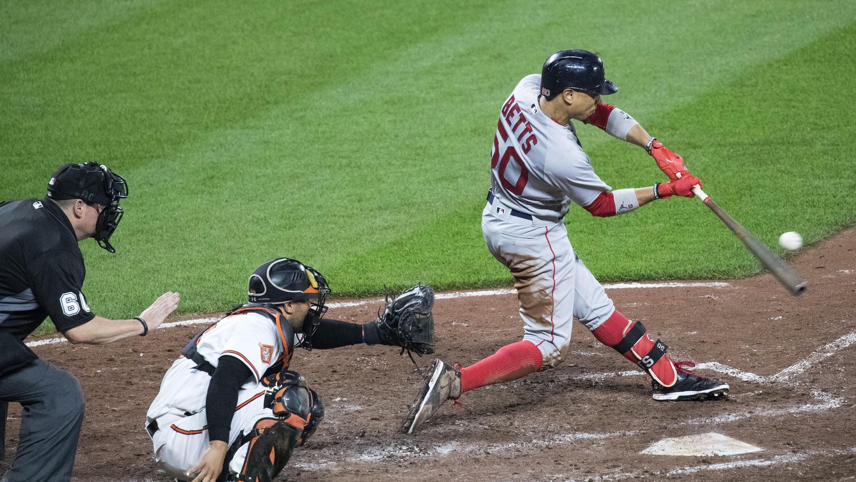


Baseball Draft Prediction
Going back from 2000 can we discover/predict if a first round pick will help their team make playoffs, win the rookie of the year or how long the player will be in the MLB!

Slide 2

First Round Draft Pick Prediction
The purpose of this analysis is to see if there is a correlation between longevity and the draft round pick of a major league baseball player.

Slide 3

Questions
Is there a correlation between first round draft picks and the team making it to playoffs?
Is there a correlation between first round draft picks and longevity in the MLB?
Is there a correlation between Rookie of the Year and the team making it to the playoffs?

Slide 4

Stats included
Overall draft pick
Initial signing salary/bonus
Average annual salary over the length of player's career
Batting and Pitching stats for their career
What awards did the players accumulate?
How many games did they play?
If the average MLB player’s career is 4-6 years, how does 1st and 2nd round players compare?
What is their overall batting average?
What is their length per initial team they were drafted?

Slide 5
Source of Data
We used two data sources from Baseball Reference (link) and Kaggle (link).
Baseball Reference was used because it gives statistics on every major league baseball player since the inception of the MLB in 1876. The site has statistics on first round draft picks dating back to 1965, that includes the player, the selecting team, position and signing bonus (link). The site also shows each rookie of the year dating back to 1947. This includes their team, league, and batting statistics (link).
Kaggle was used to gather sorted data files for teams, players, career lengths, and playoff information.

Slide 6
First year overall stats
Round Pick
Player performance
Playoffs
Salary Bonus

Slide 7
Extract
We were tasked with finding usable data from Baseball Reference and Kaggle.
Multiple CSV files were downloaded that included data for:
First round draft picks for the years 2000 – 2015
Team Names and their franchise ID
Career lengths for all players from 2000 – 2015
Post – season teams from 2000 – 2015
MLB divisions by league

Slide 8
Transform & Load
Our CSV files were transformed into Dataframes and loaded into an SQL Database.
From here we:
Removed unnecessary columns
Merge Dataframes
Changed data types
Cleaned up player names
Cleaned up team franchise ids
Filled Null columns/rows

Slide 9

Data Exploration and Analysis

Slide 10
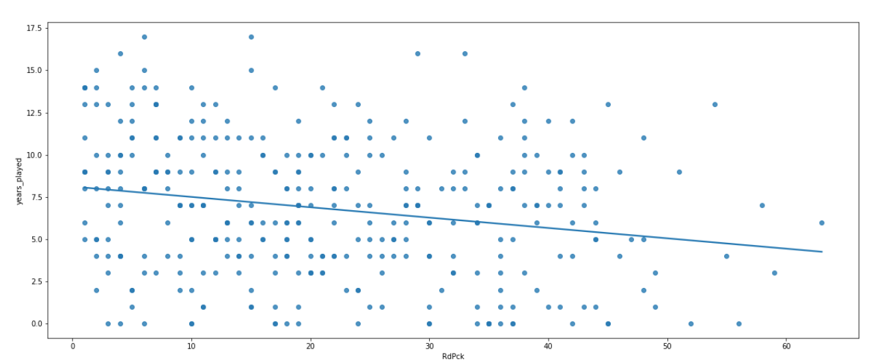
Correlation between Round pick and years played
Using a linear regression model, there is a weak negative correlation between when a player who is picked in the first round and the length of their careers.

Slide 11
Dashboard

Slide 12
Can we predict if a team will make post-season based on their first-round pick choice(s)?

Slide 13
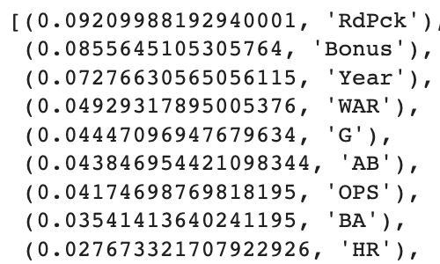
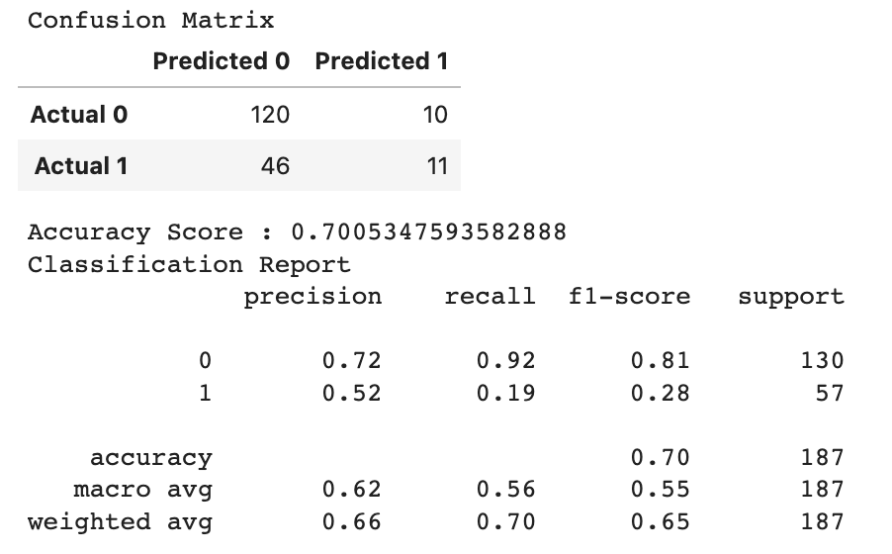
Random Forest Model
Top Features

Slide 14
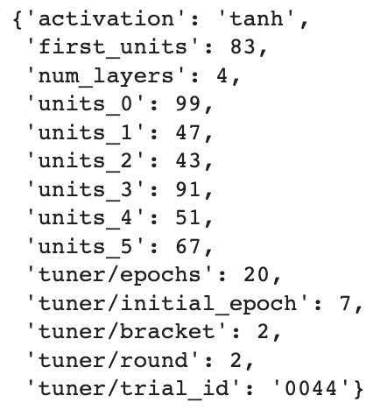
Deep Learning Model
Using Keras Tuner…
Loss: 0.580104
Accuracy: 0.770053

Slide 15
Further Investigation
Deeper analysis of playoff performance based on the top features from the Random Forest Model.
Potential difference in predictive outcome based on player position (pitcher vs fielder).
Are there additional features that could be added to improve our model(s)?

Slide 16
Can we predict if a team will make post-season based on their first-round pick choice(s)?

Slide 17
Tools Used
SQL
Baseball-reference.com
Kaggle.com
Python & Pandas
HTML
Tableau

Slide 18

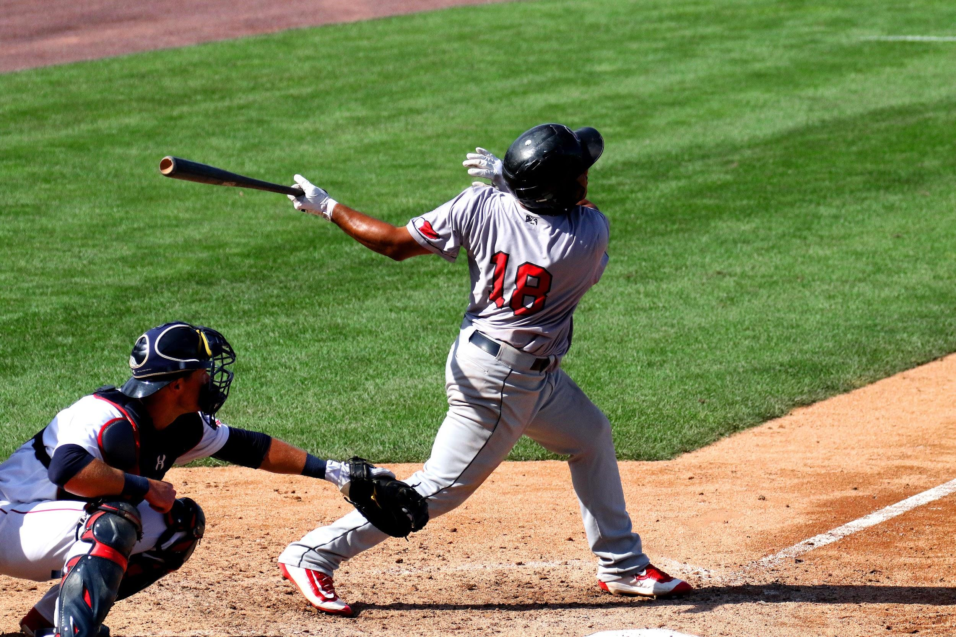







Slide 19


Contact
Your Name
no_reply@example.com
www.example.com

